Slide 1
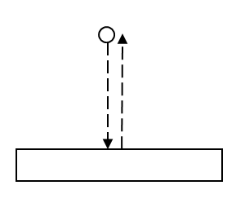
A ball bounces up and down on a floor with perfectly elastic bounces, so that the ball bounces forever. Is this an example of simple harmonic motion?
Yes
No

Slide 2
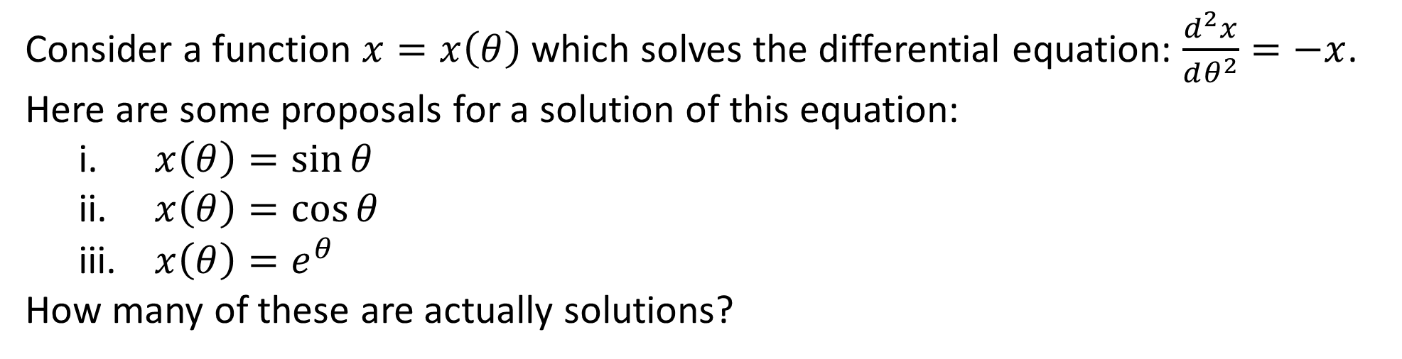
Consider a function $x=x\left(θ\right)$ which solves the differential equation: $\frac{d^{2}x}{dθ^{2}}=−x$. Here are some proposals for a solution of this equation:
  $x\left(θ\right)=\sin{θ}$
  $x\left(θ\right)=\cos{θ}$
  $x\left(θ\right)=e^{θ}$
How many of these are actually solutions?
All of them
None of them
One of them
Two of them

Slide 3
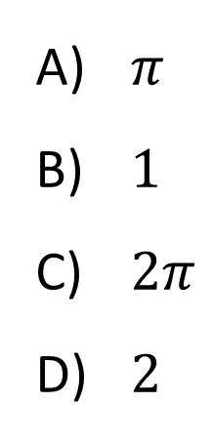
Consider the function $f\left(θ\right)=\cos{θ}$. What is $∆θ$ for one period?
$π$
$1$
$2π$
$2$

Slide 4
A mass is oscillating back and forth on a spring as shown. Position 0 is the equilibrium position. Assume that there is no friction. At which position is the magnitude of the acceleration of the mass maximum?
0
M
E
The acceleration is constant

Slide 5
A mass on an ideal spring oscillates with a certain period $T$. If the mass $m$is increased (nothing else changes), the period $T$...
increases.
decreases.
remains the same.
Not enough information

Slide 6
A mass attached to a spring oscillates with amplitude A and period T. If you double the amplitude, the period becomes…
twice as big.
four times a big.
half as big.
one fourth as big.
The period remains constant.

Slide 7
A mass attached to a spring oscillates with amplitude A and period T. If you double the amplitude, the maximum velocity becomes…
twice as big.
four times a big.
half as big.
one fourth as big.
The maximum velocity remains constant.

Slide 8
A mass attached to a spring oscillates with amplitude A and period T. If you double the amplitude, the energy of the system becomes…
twice as big.
four times a big.
half as big.
one fourth as big.
The energy of the system remains constant.

Slide 9
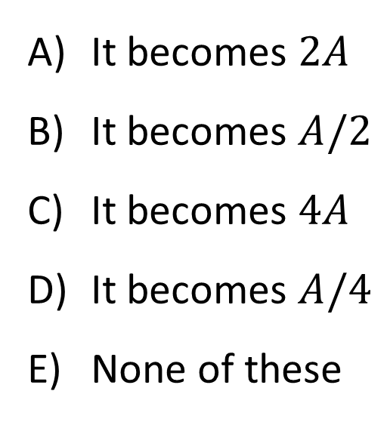
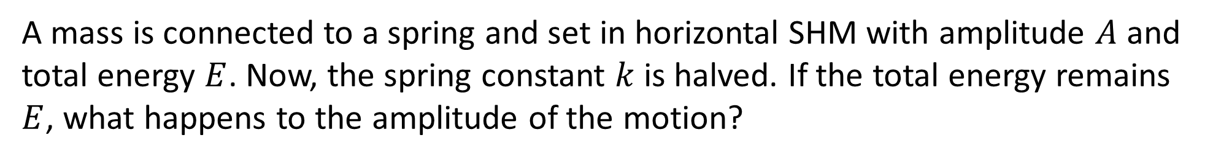
A mass is connected to a spring and set in horizontal SHM with amplitude $A$ and total energy $E$. Now, the spring constant $k$ is halved. If the total energy remains $E$, what happens to the amplitude of the motion?
It becomes $2A$
It becomes $A/2$
It becomes $4A$
It becomes $A/4$
None of these

Slide 10
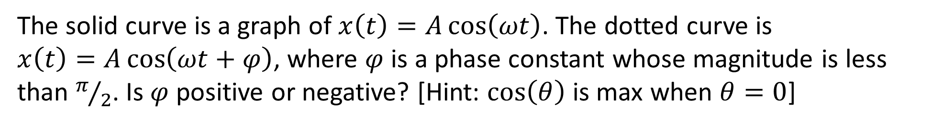
The solid curve is a graph of $x\left(t\right)=A\cos\left(ωt\right)$. The dotted curve is
$x\left(t\right)=A\cos\left(ωt+φ\right)$, where $φ$ is a phase constant whose magnitude is less than $π/2$. Is $φ$ positive or negative? [Hint: $\cos\left(θ\right)$ is max when $θ=0$]
Positive
Negative

Slide 11
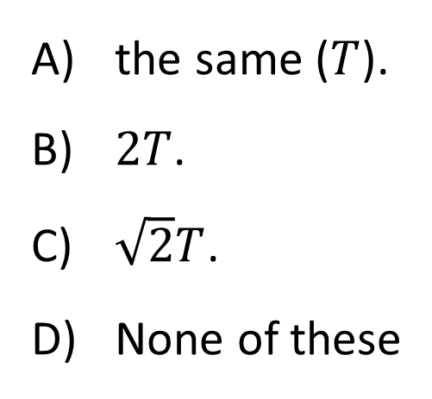
A kid is swinging on a swing with a period T. A second kid climbs on with the first, next to the first, doubling the weight on the swing. The period of the swing is now...
the same ($T$).
$2T$.
$\sqrt{2}T$.
None of these

Slide 12
You take your grandfather clock (a pendulum clock) to the Moon. On the Moon, does the clock keep good time, or run slow or fast?
Keeps good time
Runs slow
Runs fast
It stops!

Slide 13
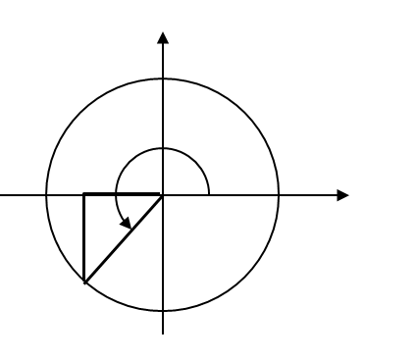
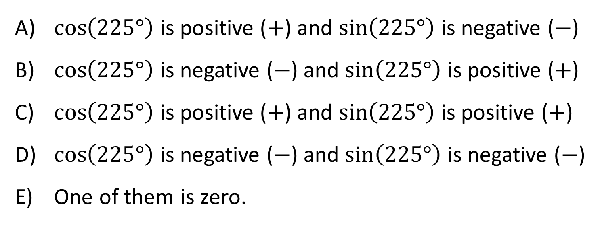
What are the signs of $\cos\left(225°\right)$ and $\sin\left(225°\right)$?
$\cos\left(225°\right)$ is positive ($+$) and $\sin\left(225°\right)$ is negative ($−$)
$\cos\left(225°\right)$ is negative ($−$) and $\sin\left(225°\right)$ is positive ($+$)
$\cos\left(225°\right)$ is positive ($+$) and $\sin\left(225°\right)$ is positive ($+$)
$\cos\left(225°\right)$ is negative ($−$) and $\sin\left(225°\right)$ is negative ($−$)
One of them is zero.

Slide 14
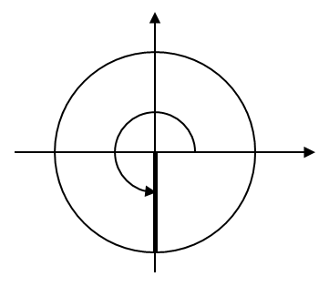
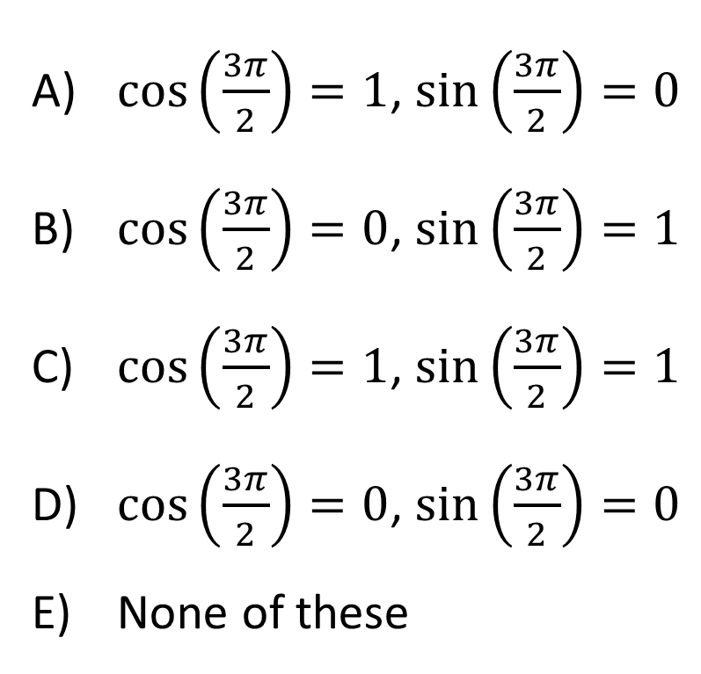
Recall that $270°=\frac{3π}{2}$. What are $\cos\left(\frac{3π}{2}\right)$ and $\sin\left(\frac{3π}{2}\right)$?
$\cos\left(\frac{3π}{2}\right)=1$, $\sin\left(\frac{3π}{2}\right)=0$
$\cos\left(\frac{3π}{2}\right)=0$, $\sin\left(\frac{3π}{2}\right)=1$
$\cos\left(\frac{3π}{2}\right)=1$, $\sin\left(\frac{3π}{2}\right)=1$
$\cos\left(\frac{3π}{2}\right)=0$, $\sin\left(\frac{3π}{2}\right)=0$
None of these

Slide 15
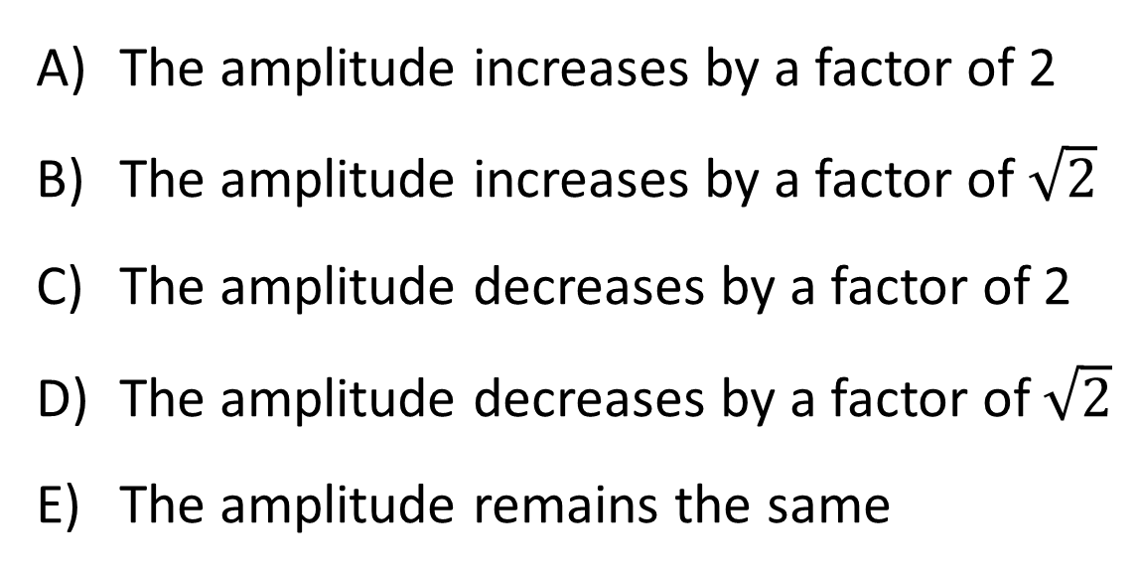
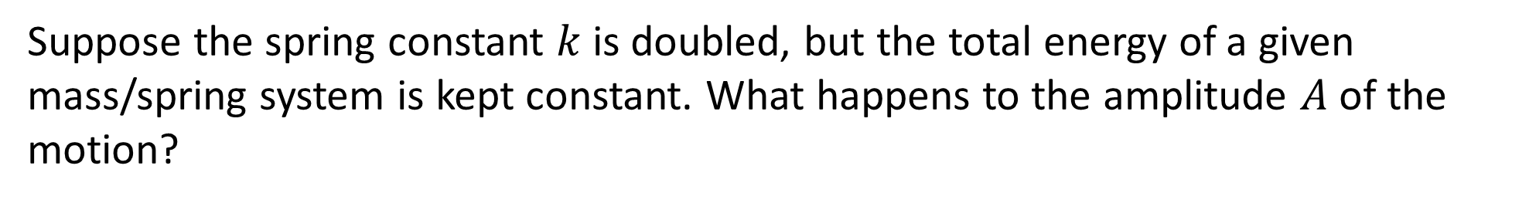
Suppose the spring constant $k$ is doubled, but the total energy of a given mass/spring system is kept constant. What happens to the amplitude $A$of the motion?
The amplitude increases by a factor of 2
The amplitude increases by a factor of $\sqrt{2}$
The amplitude decreases by a factor of 2
The amplitude decreases by a factor of $\sqrt{2}$
The amplitude remains the same

Slide 16

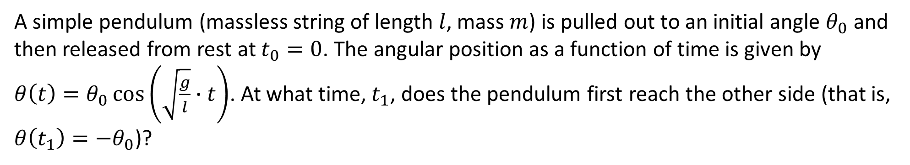
A simple pendulum (massless string of length $l$, mass $m$) is pulled out to an initial angle $θ_{0}$ and then released from rest at $t_{0}=0$. The angular position as a function of time is given by ${θ\left(t\right)=θ}_{0}\cos\left(\sqrt{\frac{g}{l}}∙t\right)$. At what time, $t_{1}$, does the pendulum first reach the other side (that is, ${θ\left(t_{1}\right)=−θ}_{0}$)?
$t_{1}=2π\sqrt{\frac{g}{l}}$
$t_{1}=π\sqrt{\frac{g}{l}}$
$t_{1}=2π\sqrt{\frac{l}{g}}$
$t_{1}=π\sqrt{\frac{l}{g}}$
$t_{1}=\frac{π}{2}\sqrt{\frac{l}{g}}$

Slide 17
A wave on a stretched drum head is an example of a…
*Note: I’m asking about the drumhead wave, not the sound wave generated by the shaking drumhead.
transverse wave.
longitudinal wave.
It’s not a wave at all

Slide 18
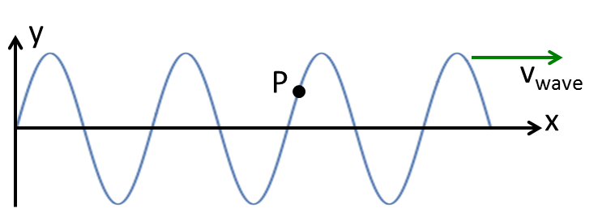
The graph below shows a snapshot of a wave on a string which is traveling to the right. There is a bit of paint on the string at point P. At the instant shown, the velocity of paint point P has which direction?
A
C
B
D
E) Other

Slide 19
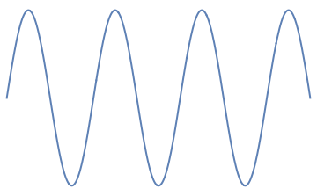
Three waves are traveling along identical strings (same mass per length, same tension, same everything). Wave B has twice the amplitude of the other two. Wave C has 1/2 the wavelength than A or B. Which wave goes slowest?
y
A
v_{wave}
x
A
B
C
Two are tied for slowest
All have same speed
y
B
v_{wave}
x
y
C
v_{wave}
x

Slide 20
Two waves are traveling along identical strings (same mass per length, same tension, same everything). Wave B has 1/2 the wavelength of A. Which wave has the higher frequency?
y
A
v_{wave}
x
y
B
v_{wave}
A
B
They have the same frequency
Not enough information
x

Slide 21
Two waves are traveling along two strings, this time you are not being told if they are identical strings! Wave B has 1/2 the wavelength of A. Which wave has the higher frequency?
y
A
x
y
B
A
B
They are have the same frequency
Not enough information
x

Slide 22
Two waves are traveling along two strings (again, you are not being told if they are identical strings). This time you are being shown a graph of the disturbance of a single point on the string as a function of time. Which wave has the highest frequency?
y
A
t
y
B
A
B
They are have the same frequency
Not enough information
t

Slide 23
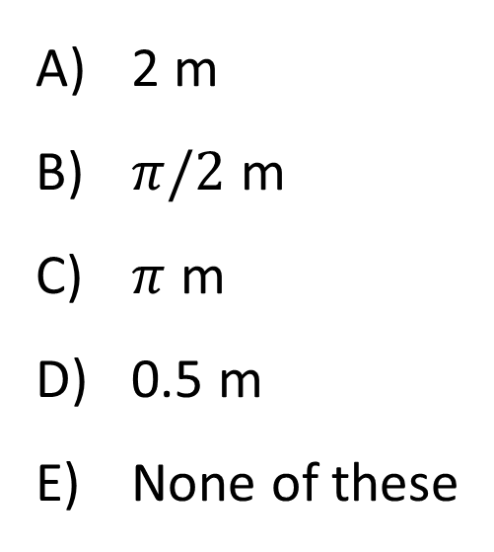
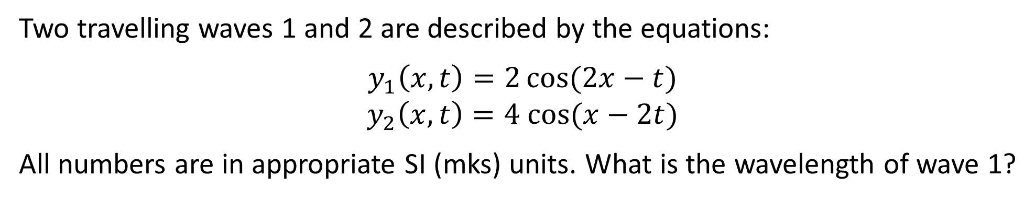
Two travelling waves 1 and 2 are described by the equations:
$$y_{1}\left(x,t\right)=2\cos{(2x−t)}$$
$$y_{2}\left(x,t\right)=4 cos⁡(x−2t)$$
All numbers are in appropriate SI (mks) units. What is the wavelength of wave 1?
2 m
$π/2$ m
$π$ m
0.5 m
None of these

Slide 24
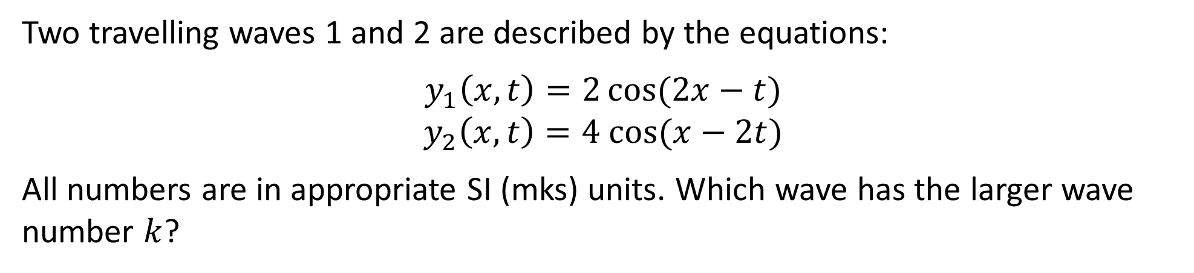
Two travelling waves 1 and 2 are described by the equations:
$$y_{1}\left(x,t\right)=2\cos{(2x−t)}$$
$$y_{2}\left(x,t\right)=4 cos⁡(x−2t)$$
All numbers are in appropriate SI (mks) units. Which wave has the larger wave number $k$?
Wave 1
Wave 2
Both have the same wave number

Slide 25
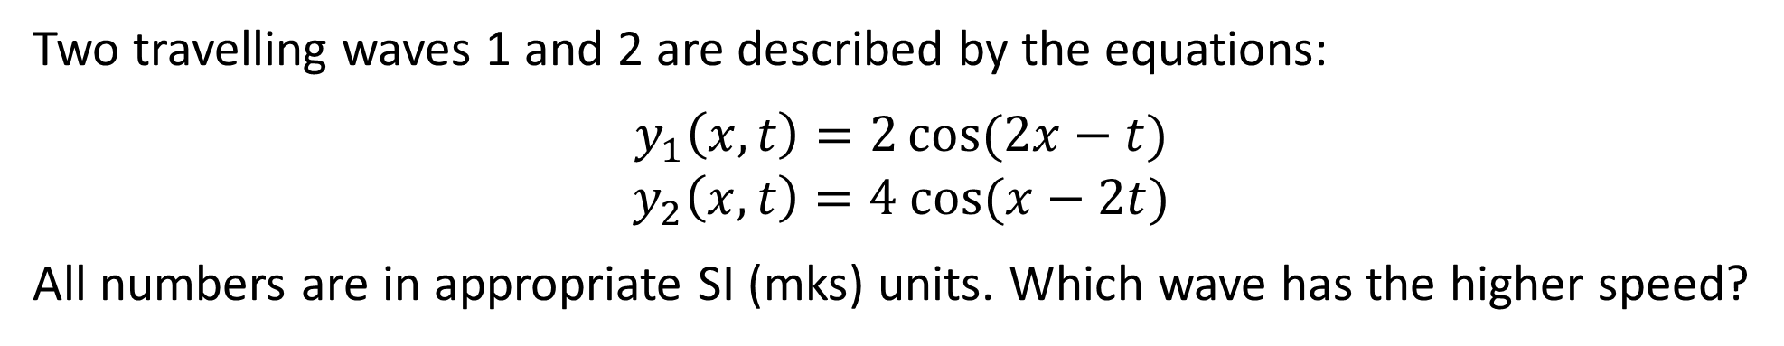
Two travelling waves 1 and 2 are described by the equations:
$$y_{1}\left(x,t\right)=2\cos{(2x−t)}$$
$$y_{2}\left(x,t\right)=4 cos⁡(x−2t)$$
All numbers are in appropriate SI (mks) units. Which wave has the higher speed?
Wave 1
Wave 2
Both have the same speed

Slide 26
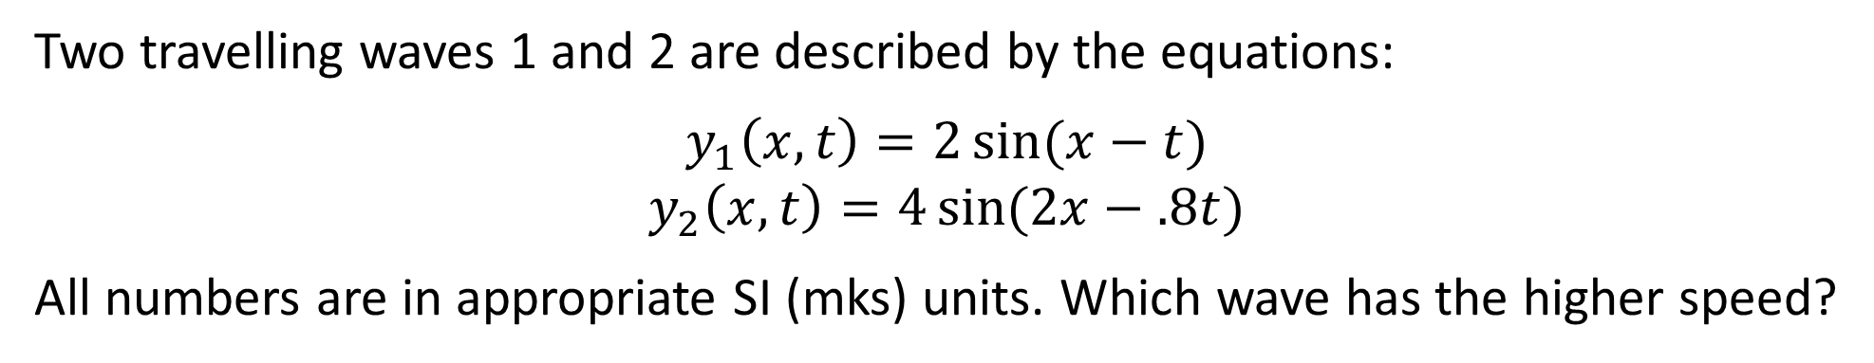
Two travelling waves 1 and 2 are described by the equations:
$$y_{1}\left(x,t\right)=2\sin{(x−t)}$$
$$y_{2}\left(x,t\right)=4\sin{(2x−.8t)}$$
All numbers are in appropriate SI (mks) units. Which wave has the higher speed?
Wave 1
Wave 2
Both have the same speed

Slide 27
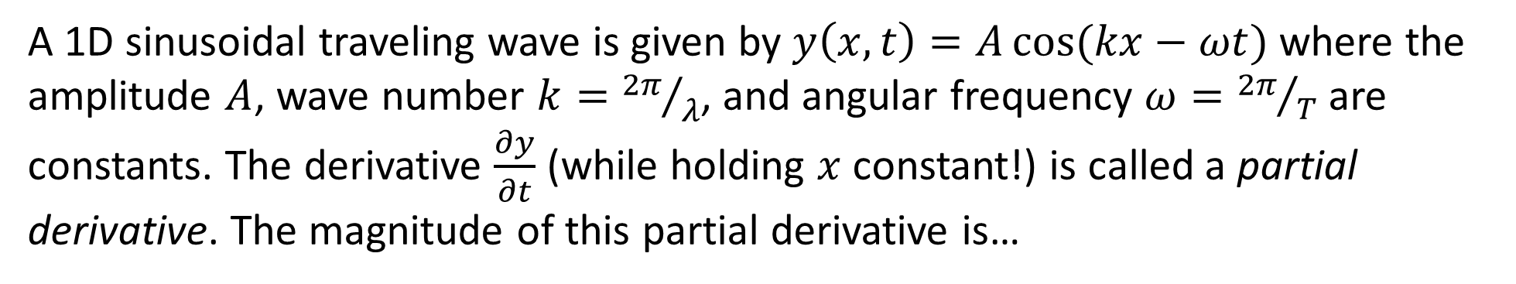
A 1D sinusoidal traveling wave is given by $y\left(x,t\right)=A\cos{(kx−ωt)}$ where the amplitude $A$, wave number $k={2π}/λ$, and angular frequency $ω={2π}/T$ are constants. The derivative $\frac{∂y}{∂t}$ (while holding $x$ constant!) is called a partial derivative. The magnitude of this partial derivative is…
the speed of the wave.
something else.

Slide 28
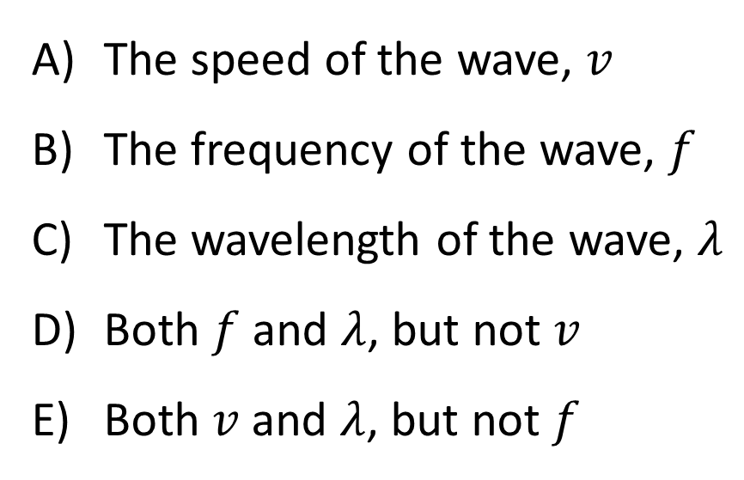
When a sound wave passes from air into water, what properties of the wave will change?
The speed of the wave, $v$
The frequency of the wave, $f$
The wavelength of the wave, $λ$
Both $f$ and $λ$, but not $v$
Both $v$ and $λ$, but not $f$

Slide 29
A string is clamped at both ends and plucked so it vibrates in a standing wave mode between extreme positions A and C. Let upward motion correspond to + velocities. When the string is in position B, the instantaneous velocity of points along the string is...
0 everywhere
+ everywhere
- everywhere
Depends on position!

Slide 30
A string is clamped at both ends and plucked so it vibrates in a standing wave mode between extreme positions A and C. Let upward motion correspond to + velocities. When the string is in position C, the instantaneous velocity of points along the string is...
0 everywhere
+ everywhere
- everywhere
Depends on position!

Slide 31
The graph below shows a snapshot of a wave on a string which is traveling to the right. There is a bit of paint on the string at point P. At the instant shown, the acceleration of paint point P has which direction?
A
C
B
D
E) Other

Slide 32
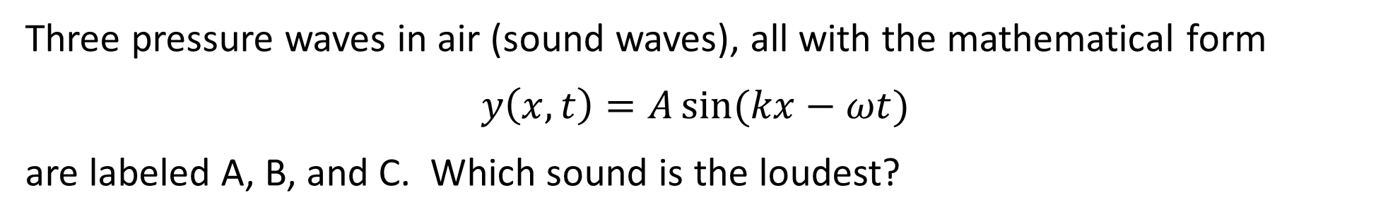
Three pressure waves in air (sound waves), all with the mathematical form
$$y\left(x,t\right)=A\sin{(kx−ωt)}$$
are labeled A, B, and C. Which sound is the loudest?
y
y
A
B
t
t
y
C
t
D) more than one tie for loudest

Slide 33
Two impulse waves approach each other. Which picture best shows the string when the waves are passing through each other?
A
B
C
D

Slide 34
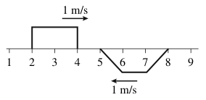
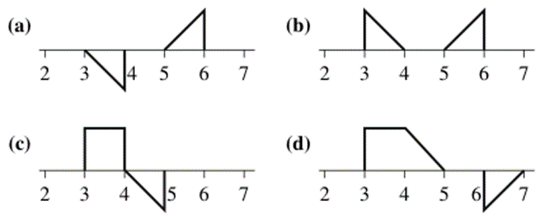
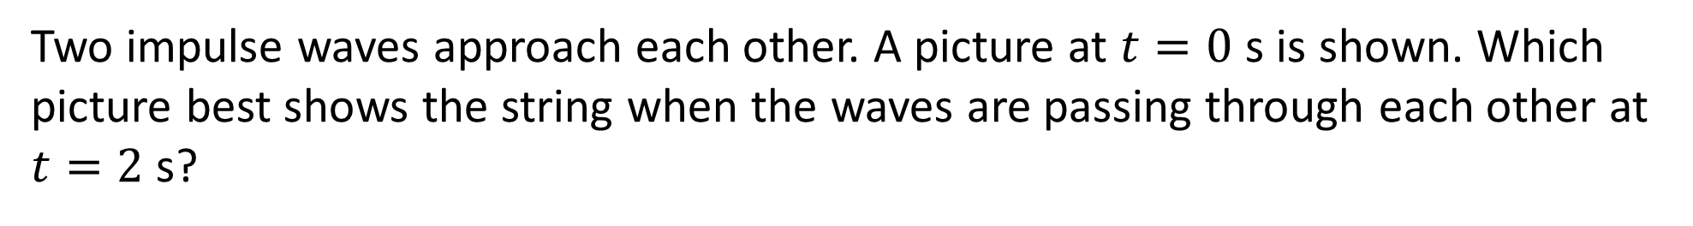
Two impulse waves approach each other. A picture at $t=0$ s is shown. Which picture best shows the string when the waves are passing through each other at $t=2$ s?

Slide 35
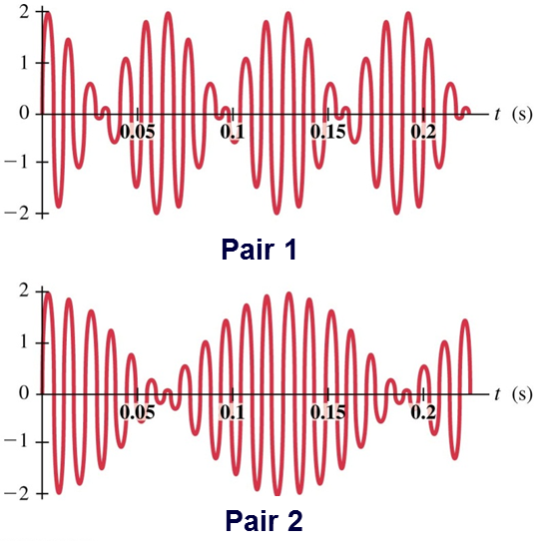
The traces below show beats that occur when two different pairs of waves interfere. For which case is the difference in frequency of the original waves greater?
Pair 1
Pair 2
Same for both pairs
Impossible to tell by just looking

Slide 36
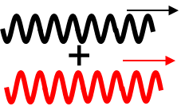
Two traveling sine waves (same freq., in phase) travel together (same direction) in the same material, in the same place... What happens when they “superpose”?
Exact same as either one individually
A traveling wave, but twice the amplitude
A traveling wave that gets bigger and smaller in amplitude as time goes by (i.e. “beats”)
Something else entirely...

