Slide 1
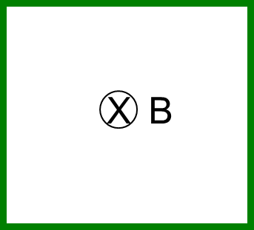
Imagine a square imaginary loop. There is a uniform B-field in the region as shown. How does the magnitude of the magnetic flux $\left|Φ_{B}\right|$ change if we half the B-field strength and double the length of the sides of the square?
$\left|Φ_{B}\right|$ decreases by a factor of 2
$\left|Φ_{B}\right|$ decreases by a factor of 4
$\left|Φ_{B}\right|$ remains the same
$\left|Φ_{B}\right|$ increases by a factor of 2
$\left|Φ_{B}\right|$ increases by a factor of 4

Slide 2
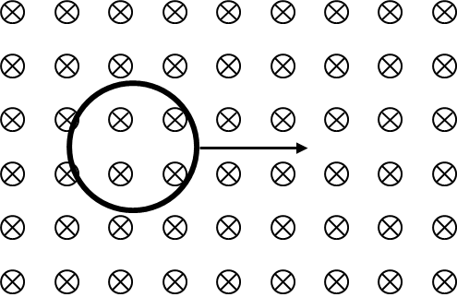
A loop of wire is moving rapidly through a uniform magnetic field. Is a non-zero current induced in the loop (assuming it remains within the region of the field)?
Yes, there is
No, there is not

Slide 3
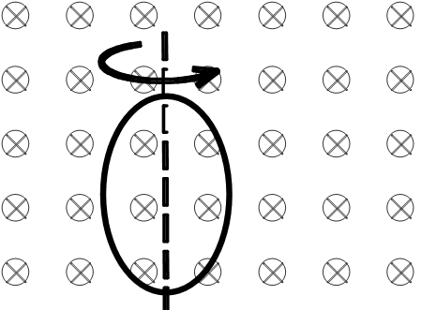
A loop of wire is spinning rapidly about a stationary axis in a uniform B- field. Is a non-zero current induced in the loop?
Yes, there is
No, there is not

Slide 4
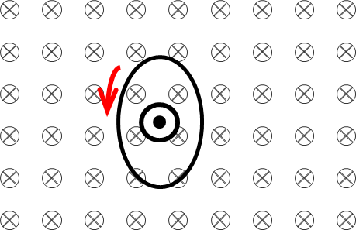
What if that loop were spun around an axis oriented perpendicular to the plane of the page, running through the center? Is a non-zero current induced in the loop?
Yes, there is
No, there is not

Slide 5
What if that loop were spun around an axis oriented perpendicular to the plane of the page, running through the center? Is a non-zero current induced in the loop?
Yes, there is
No, there is not

Slide 6
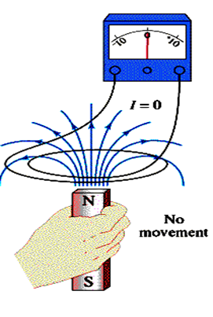
In order to change the magnetic flux through the loop, what would you have to do?
Drop the magnet
Move the magnet upward
Move the magnet sideways
Only A) or B) will work
A), B), or C) will work

Slide 7
The magnetic flux through a loop of wire is shown. At which time is the magnitude of the emf induced in the loop a maximum?
A
B
C
D
same at all times

Slide 8
A loop of wire is sitting in a uniform, constant magnet field as shown. Suddenly, the loop is bent into a smaller area loop. During the bending of the loop, there will be an induced EMF that will create an induced current in the loop. This induced current will create a magnetic field in the loop that is…
Left
Right
Into the board
Out of the board

Slide 9
A loop of wire is sitting in a uniform, constant magnet field as shown. Suddenly, the loop is bent into a smaller area loop. We have decided that the induced current will create a magnetic field in the loop that is into the board. Which direction must the induced current be flowing?
Clockwise
Counterclockwise

Slide 10
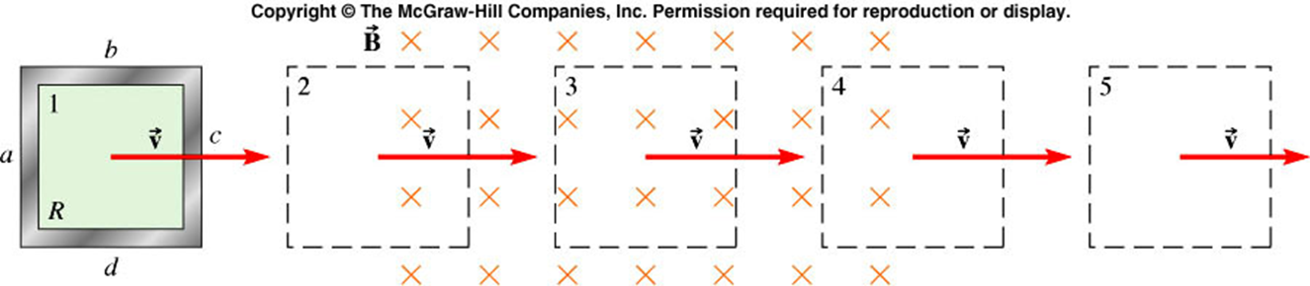
A square metal loop moves at constant velocity v through a region with a magnetic field directed into the page. At which point(s) does the induced current in the loop flow clockwise?
2
3
4
both 2 and 4

Slide 11
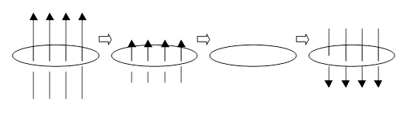
A horizontal loop of wire is in a vertical magnetic field. (caused by an external magnet). The magnetic field varies smoothly from pointing upward to pointing downward, as shown. (The B-field gradually gets smaller, goes to zero, then grows in the other direction.) At the moment when the external magnetic field in the loop is zero, is there an induced current in the loop?
Yes
No

Slide 12
A horizontal loop of wire is in a vertical magnetic field. (caused by an external magnet). The magnetic field varies smoothly from pointing upward to pointing downward, as shown. (The B-field gradually gets smaller, goes to zero, then grows in the other direction.) At the moment when the external B-field in the loop is zero, what is the direction of the induced current?
Clockwise (as seen from above)
Counterclockwise (as seen from above)
No direction because the induced current is reversing direction

Slide 13
A loop of wire is moving rapidly through a uniform magnetic field as shown. The induced current in the loop flows…?
Clockwise
Counterclockwise
There is no induced current

Slide 14
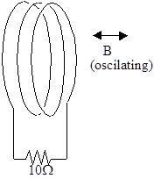
A coil of wire attached to a resistor is in an oscillating magnetic field, as shown. The B-field vs. time is shown. At what point in time is the magnitude of the current through the resistor a maximum?
don’t choose this…
B
C
D
E

Slide 15
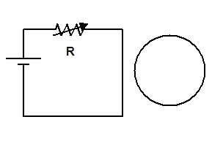
A circuit with a battery and a variable resistor is near a loop of wire as shown. When the resistance R is decreased, the induced current in the loop is…
Clockwise (CW)
Counterclockwise (CCW)
Zero

Slide 16
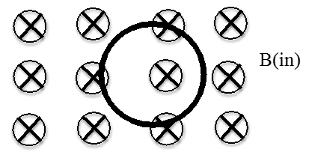
A loop of wire sits in a uniform B field (shown) which is steadily increasing in magnitude. The current induced in the loop is…
Clockwise (CW)
Couterclockwise (CCW)
No induced current

Slide 17
A loop of wire sits in a uniform B field (shown) which is steadily increasing in magnitude. Lenz’s law tells us that the induced current will flow counterclockwise. Once it starts flowing, this induced current will feel a force (due to the external B) that…
tries to move the loop out of the page.
tries to move the loop into the page.
tries to expand the loop (stretch it out, increasing its radius).
tries to contract the loop (shrink it, decreasing its radius).

Slide 18
A bar magnet is positioned below a horizontal loop of wire with its North pole pointing toward the loop. Then the magnet is pulled down, away from the loop. As viewed from above, is the induced current in the loop clockwise or counterclockwise?

Slide 19
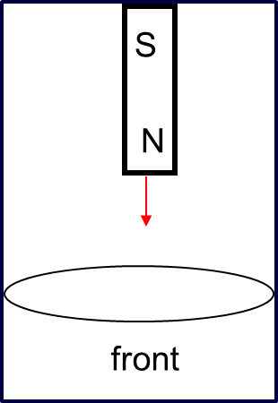
A magnet falls towards a conducting ring. As it falls, a current is induced in the ring. Does this induced current…
have no effect on the magnet
repel (hold up) the magnet
attract (pull down) the magnet

Slide 20
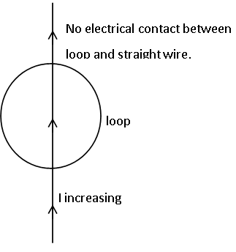
A long, straight wire carrying an increasing current I passes along a diameter of a wire loop. The straight wire and the loop are in the same plane but are not in electrical contact. The induced current in the loop is…
zero
counterclockwise
clockwise

Slide 21
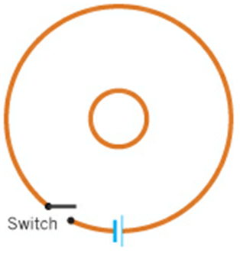
The drawing shows a top view of two circular coils of conducting wire lying on a flat surface. The centers of the coils coincide. In the larger coil there is a switch and a battery. The smaller coil contains no switch and no battery. Describe the induced current that appears (or not) in the smaller coil when the switch in the larger coil is closed.
It flows counterclockwise forever after the switch is closed
It flows clockwise forever after the switch is closed
It flows counterclockwise, but only for a short period just after the switch is closed
It flows clockwise, but only for a short period just after the switch is closed

Slide 22
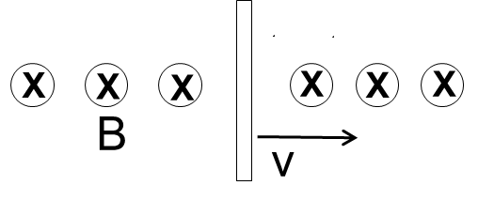
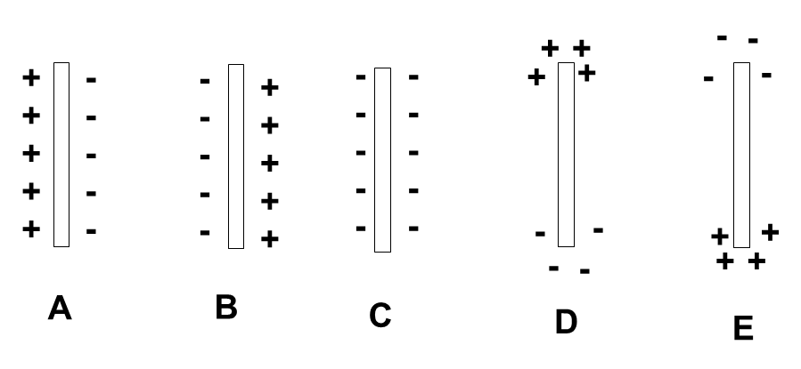
A metal bar moves with speed v in a region where there is a uniform magnetic field as shown. How do the charges separate inside the copper bar as it is moved through a region of uniform magnetic field?

Slide 23
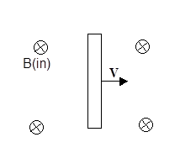
A metal bar (not attached to any outside circuitry) is moving through a uniform magnetic field as shown. The electric field E within the bar is…
non-zero and downward ↓
non-zero and upward ↑
zero

Slide 24
What is the magnitude of the potential difference from the top to the bottom of the rod (length $L$)?
qvBL
BL
vBL
2vBL
zero

Slide 25
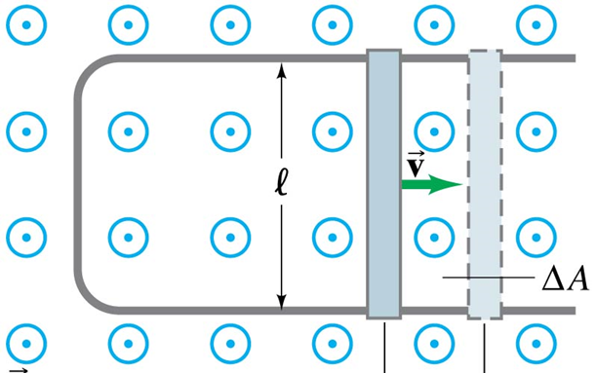
While the rod slides right, what is the magnetic force on the sliding rod?
Left
Right
Up
Out of the page
No magnetic force

Slide 26
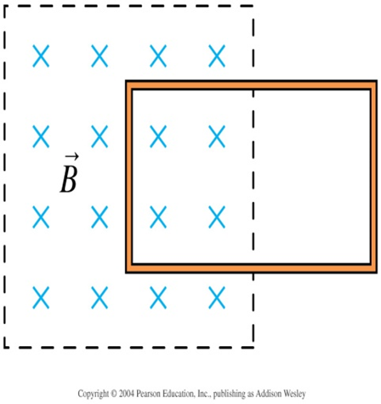
A conducting loop is halfway into a magnetic field. Suppose the loop is given a quick push to the left so that the flux through the loop begins to increase. Which direction is the induced current?
Clockwise
No induced current
Counterclockwise

Slide 27
We have seen that the quick push to the left caused a counterclockwise induced current. If this push is not sustained, what happens to the loop? [Assume the loop is large so that it remains only partially in the region of magnetic field]
It accelerates to the left
It moves with constant speed to the left
It slows down to a stop
It slows down to a stop and then accelerates to the right

Slide 28
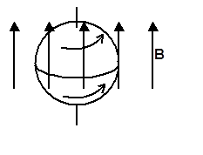
A uniform solid sphere of copper rotates about a stationary axis in a uniform magnetic field B. Are there eddy currents?
Yes, there are eddy currents.
No, there are no eddy currents.

Slide 29
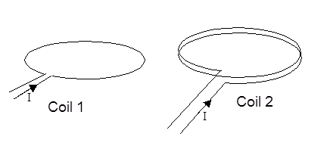
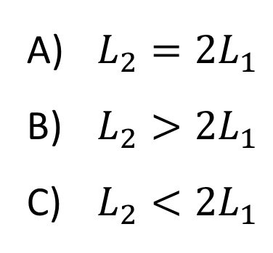
Inductor 1 consists of a single loop of wire. Inductor 2 is identical to inductor 1 except that it has two loops. How do the self-inductances of the two loops compare?
$L_{2}=2L_{1}$
$L_{2}>2L_{1}$
$L_{2}<2L_{1}$

Slide 30
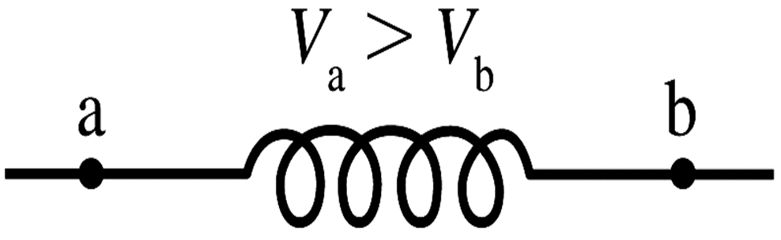
Current is flowing through an inductor (only part of the circuit is shown). A voltmeter measures $V_{a}>V_{b}$. Which of the statements could be true?
Current is flowing from a to b and is steady.
Current is flowing from a to b and increasing.
Current is flowing from a to b and decreasing.
Current is flowing from b to a and steady.
Current is flowing from b to a and increasing.

Slide 31
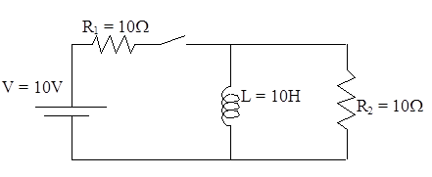
An LR circuit is shown below. Initially the switch is open. At time t=0, the switch is closed. What is the current through the inductor L immediately after the switch is closed (time t=0+ε)?
Zero
1 A
0.5 A
2 A
none of these

Slide 32
An LR circuit is shown below. Initially the switch is open. At time t=0, the switch is closed. After a long time, what is the current through the battery?
Zero
1 A
0.5 A
2 A
none of these

Slide 33
Now suppose the switch has been closed for a long time and is then opened. Immediately after the switch is opened, the current through $R_{2}$ is…
zero
not zero

Slide 34
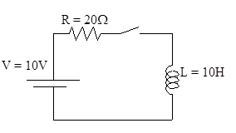
The switch in the circuit below is closed at t=0. What is the current through the resistor immediately after the switch is closed?
0 A
0.5 A
1 A
10 A
none of these

Slide 35
The switch in the circuit below is closed at t=0. What is the initial rate of change of current dI/dt in the inductor, immediately after the switch is closed? [Hint: what is the intial voltage across the inductor?
0 A/s
0.5 A/s
1 A/s
10 A/s
none of these

Slide 36
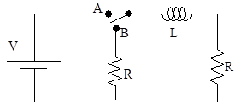
The circuit shown has two resistors, both with resistance R, an inductor with inductance L, a battery with constant voltage V, and a switch which can be in position A or B. Suppose the switch has been in position A for a long time and is then switched to position B. Immediately after the switch is thrown to B, what is the current in the inductor?
zero
V/R
V/(2R)
2V/R
None of these

Slide 37
The circuit shown has two resistors, both with resistance R, an inductor with inductance L, a battery with constant voltage V, and a switch which can be in position A or B. Suppose the switch has been in position A for a long time and is then switched to position B. Immediately after the switch is thrown to B, what is the voltage across the inductor L?
zero
V
2V
V/2
None of these

Slide 38
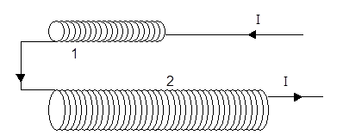
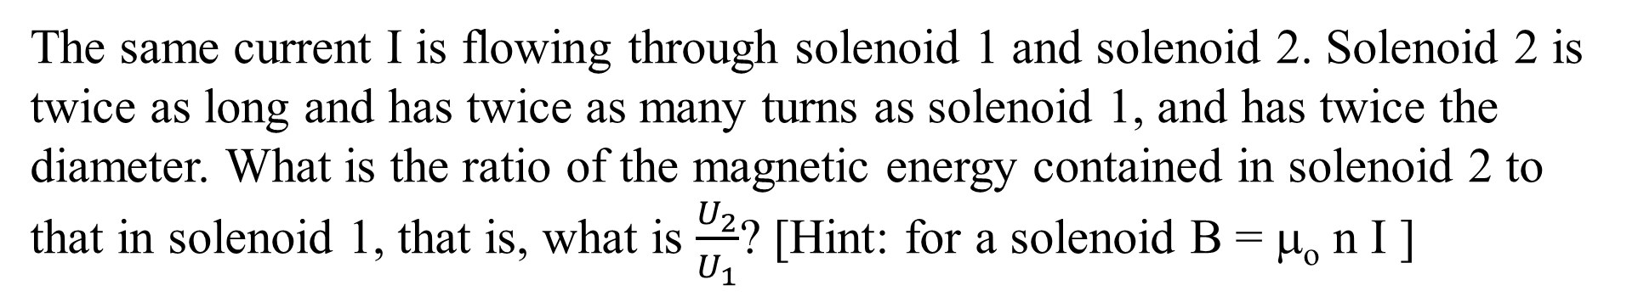
The same current I is flowing through solenoid 1 and solenoid 2. Solenoid 2 is twice as long and has twice as many turns as solenoid 1, and has twice the diameter. What is the ratio of the magnetic energy contained in solenoid 2 to that in solenoid 1, that is, what is $\frac{U_{2}}{U_{1}}$? [Hint: for a solenoid B = μ_{o} n I ]
2
4
8
16
none of these

Slide 39
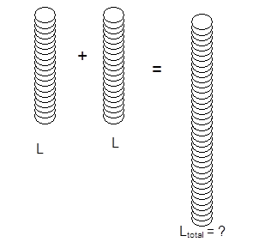
Two long solenoids, each of inductance L, are connected together to form a single very long solenoid of inductance L_{total}. What is L_{total}?
2L
4L
8L
none of these

Slide 40
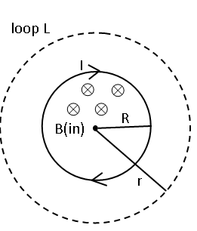
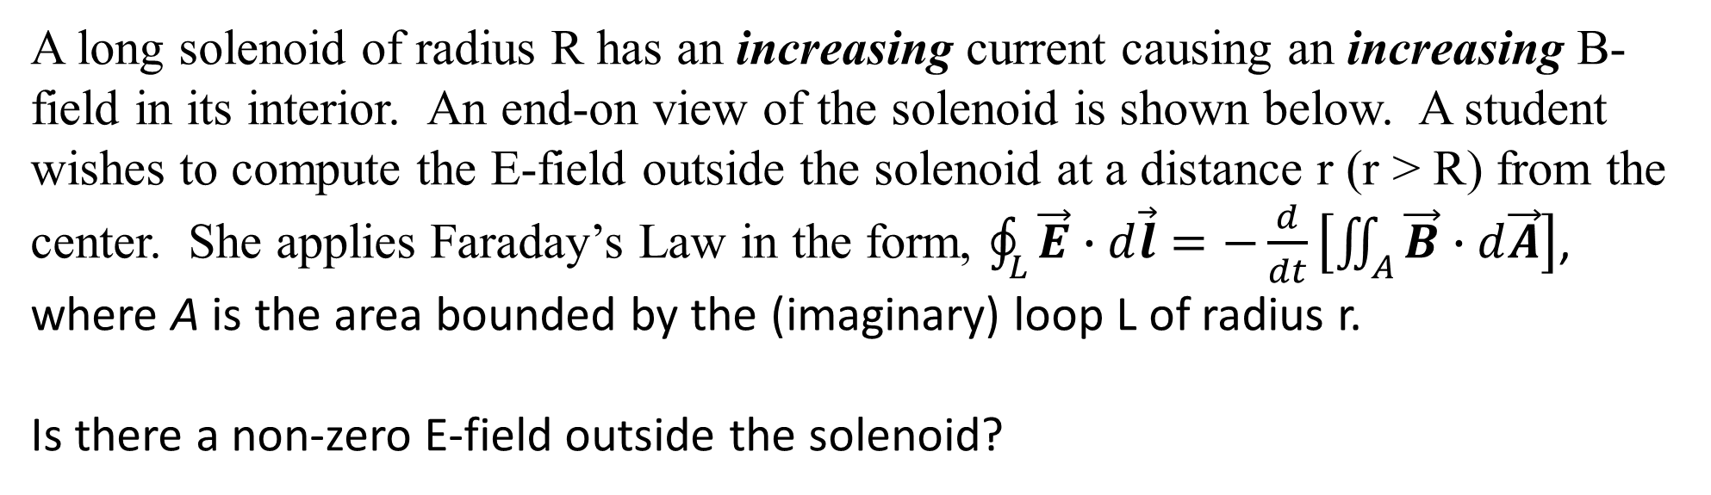
A long solenoid of radius R has an increasing current causing an increasing B-field in its interior. An end-on view of the solenoid is shown below. A student wishes to compute the E-field outside the solenoid at a distance r (r > R) from the center. She applies Faraday’s Law in the form, $\oint_{L}^{ }{\vec{E}∙d\vec{l}}=−\frac{d}{dt}\left[\iint_{A}^{ }{\vec{B}∙d\vec{A}}\right]$, where A is the area bounded by the (imaginary) loop L of radius r.
Is there a non-zero E-field outside the solenoid?
No, E=0 outside the solenoid
Yes, the E-field circulates CCW
Yes, the E-field circulates CW
Yes, there is a radial E-field

Slide 41

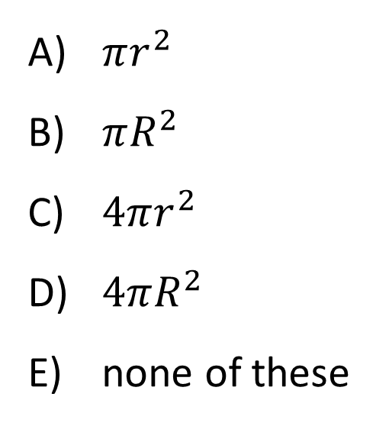
The student begins by writing $−\frac{d}{dt}\left[\iint_{A}^{ }{\vec{B}∙d\vec{A}}\right]=−\frac{d}{dt}\left(BA\right)=−A\frac{dB}{dt}$
What is the correct expression for A?
$πr^{2}$
$πR^{2}$
$4πr^{2}$
$4πR^{2}$
none of these

Slide 42
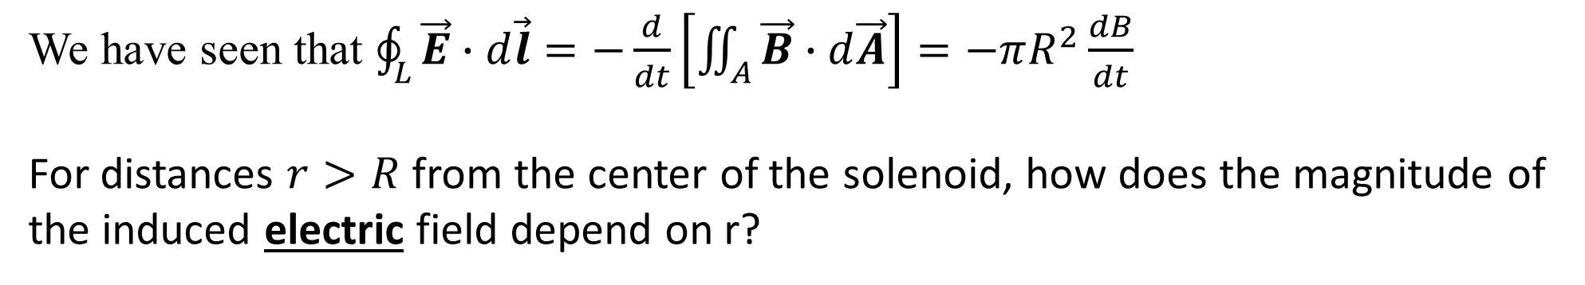
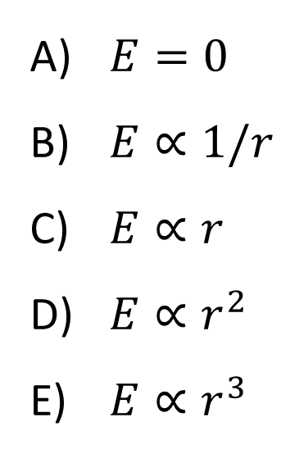
We have seen that $\oint_{L}^{ }{\vec{E}∙d\vec{l}}=−\frac{d}{dt}\left[\iint_{A}^{ }{\vec{B}∙d\vec{A}}\right]=−πR^{2}\frac{dB}{dt}$
For distances $r>R$ from the center of the solenoid, how does the magnitude of the induced electric field depend on r?
$E=0$
$E∝1/r$
$E∝r$
$E∝r^{2}$
$E∝r^{3}$

Slide 43
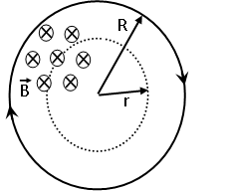
Now suppose the path is inside the solenoid (she is trying to find the electric field at positions where r < R).
How does the magnitude of the induced electric field depend on r?
$E=0$
$E∝1/r$
$E∝r$
$E∝r^{2}$
$E∝r^{3}$

Slide 44
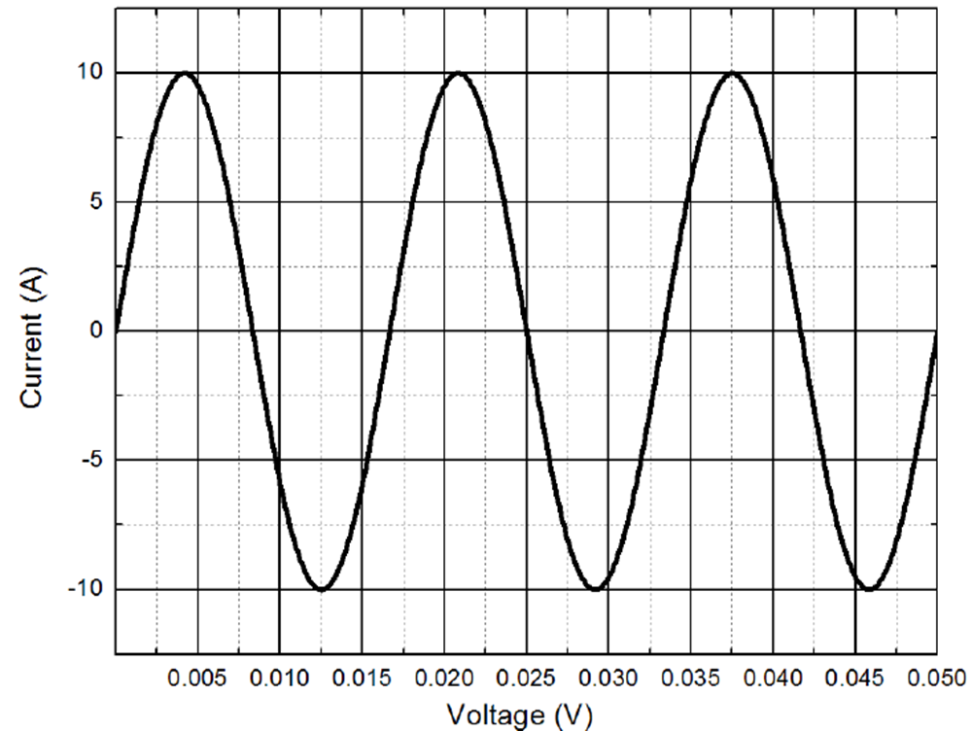
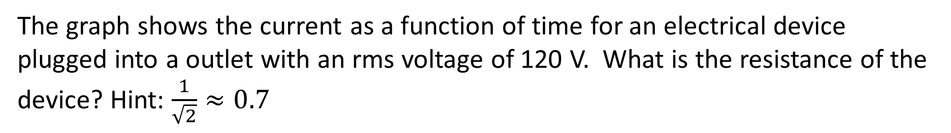
The graph shows the current as a function of time for an electrical device plugged into a outlet with an rms voltage of 120 V. What is the resistance of the device? Hint: $\frac{1}{\sqrt{2}}≈0.7$
24 Ω
21 Ω
17 Ω
14 Ω
12 Ω
Time (s)

Slide 45
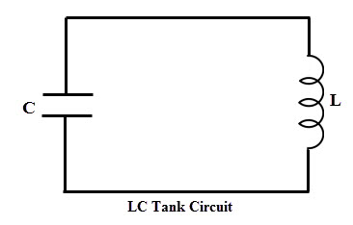
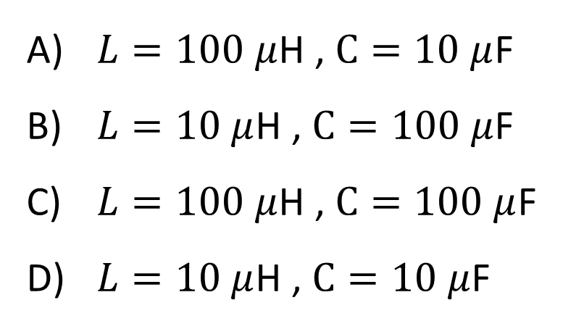
You are building an LC oscillator circuit and you would like to maximize the oscillator’s frequency. Which components should you choose?
$L=100 μ$H , $C=10 μ$F
$L=10 μ$H , $C=100 μ$F
$L=100 μ$H , $C=100 μ$F
$L=10 μ$H , $C=10 μ$F

Slide 46
The current in an oscillating LC circuit is zero. Which one of the following statements is true?
The charge on the capacitor is equal to zero coulombs.
Charge is moving through the inductor.
The energy is equally shared between the electric and magnetic fields.
The energy in the electric field is maximized.
The energy in the magnetic field is maximized.

Slide 47
An ac voltage source $V\left(t\right)=V_{0}\sin{(ωt)}$ is connected to a resistor. What is the average power dissipated by the resistor?
zero
positive
negative
not enough information

Slide 48
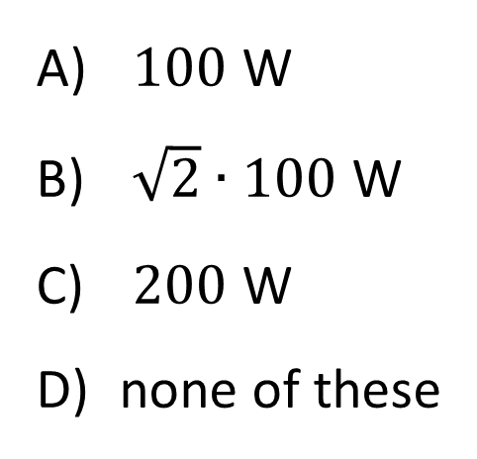
A 100 W light bulb (average power) is attached to a wall plug (120 V rms, 60 Hz). What is the peak power output to the bulb?
$100$ W
$\sqrt{2}∙100$ W
$200$ W
none of these

Slide 49
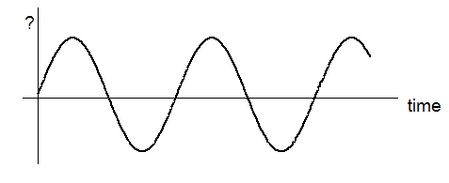
A resistor with resistance R is plugged into a 120 V AC wall socket. The graph below is either voltage V across, current I thru, or power P dissipated in the resistor vs. time. What could the graph be?
V only
I only
V or I only
V, I, or P
Some other combination

Slide 50

A transformer is connected to a battery as shown. The voltage across the resistor R is…
$V\frac{N_{2}}{N_{1}}$
$V\frac{N_{1}}{N_{2}}$
$V$
zero
not enough information to answer

Slide 51

A transformer is connected to an AC generator as shown. The voltage across the resistor R is…
$$V$$
$V\frac{N_{2}}{N_{1}}$
$V\frac{N_{1}}{N_{2}}$
$V$
zero
not enough information to answer

Slide 52
The primary coil of a transformer is connected to a battery, a resistor, and a switch. The secondary coil is connected to an ammeter. When the switch is thrown closed, the ammeter shows…
a zero current all the time
a non-zero current for a brief time when the switch is closed
a steady non-zero current after the switch is closed

Slide 53
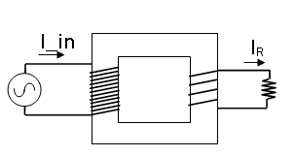
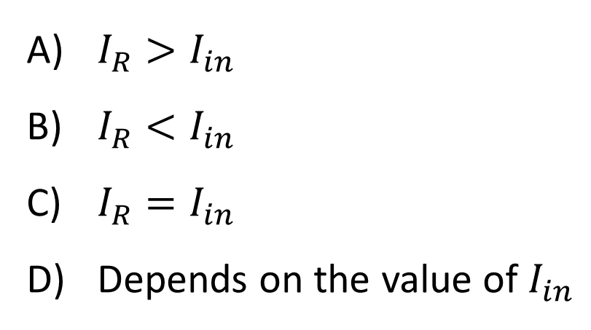
A step-down transformer is attached to an AC voltage source and a resistor as shown. How does the current in the resistor I R compare to the current drawn from the AC source Iinput? (With AC circuits, we always use rms values of I and V.)
$I_{R}>I_{in}$
$I_{R}<I_{in}$
$I_{R}=I_{in}$
Depends on the value of $I_{in}$

Slide 54
An electrical engineer at a power plant wants to reduce the energy wasted during power transmission from the plant to the city. The power output $P_{o}=IV$ of the plant is fixed at 100 MW. The engineer decides to double the output voltage V. By what factor does the power lost in the cable $P_{lost}=I^{2}R_{cable}$ change?
No change
Factor of 2 decrease in power lost
Factor of 4 decrease in power lost
Factor of 8 decrease in power lost
Power lost in cable actually increases

