Slide 1
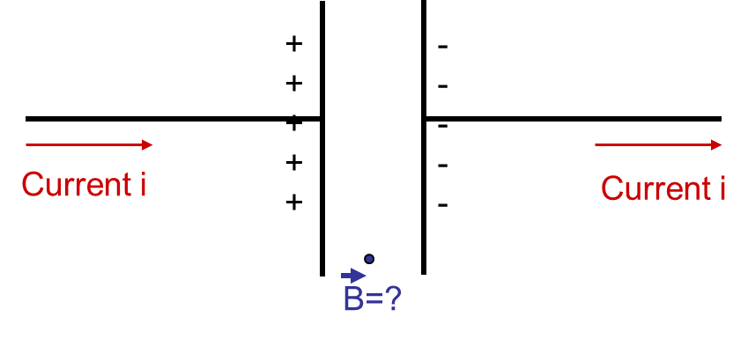
Consider the Biot-Savart Law for magnetic fields. Is there a magnetic field at the point labeled between the plates?
Yes, there is a B-field
No, there is zero B-field

Slide 2
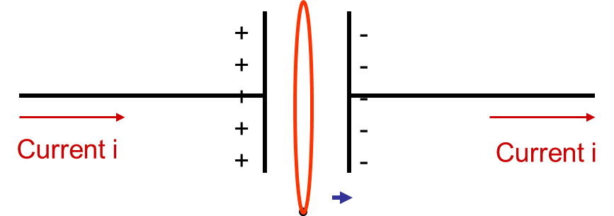
Now consider an Amperian Loop as drawn. According to Ampere’s Law is there a magnetic field at the point labeled between the plates?
B=?
Yes, there is a B-field
No, there is zero B-field

Slide 3
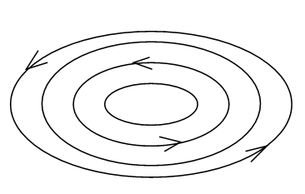
Consider the following configuration of field lines. This could be a…
E-field
B-field
Either E or B

Slide 4
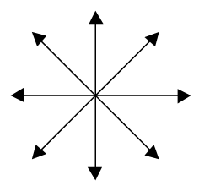
Consider the following configuration of field lines. This could be a…
E-field
B-field
Either E or B

Slide 5
Two traveling waves 1 and 2 are described by the equations
$$y_{1}\left(x,t\right)=2\sin{(2x−t)}$$
$$y_{2}\left(x,t\right)=4\sin{(x−2t)}$$
The wavelength λ of wave 1 is most nearly…
1 m
2 m
3 m
4 m
Impossible to tell

Slide 6
Two traveling waves 1 and 2 are described by the equations
$$y_{1}\left(x,t\right)=2\sin{(2x−t)}$$
$$y_{2}\left(x,t\right)=4\sin{(x−2t)}$$
All the numbers are in the appropriate SI units. Which wave has the higher speed?
Wave 1
Wave 2
Both have the same speed

Slide 7
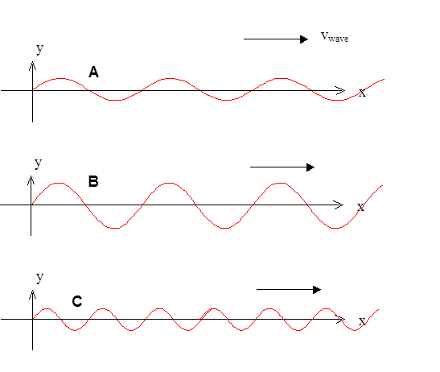
Three waves are traveling along identical strings (same mass per length, same tension, same everything). Wave B has twice the amplitude of the other two. Wave C has 1/2 the wavelength than A or B. Which wave goes slowest?
A
B
C
All have same v

Slide 8
Three waves are traveling along identical strings (same mass per length, same tension, same everything). Wave B has twice the amplitude of the other two. Wave C has 1/2 the wavelength than A or B. Which wave has the highest frequency?
A
B
C
All have same f

Slide 9
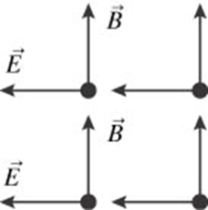
A plane electromagnetic wave has electric and magnetic fields at all points in the plane as noted below. With the fields oriented as shown, the wave is moving…
into the plane of the paper
out of the plane of the paper
to the left
to the right
toward the top of the paper

Slide 10
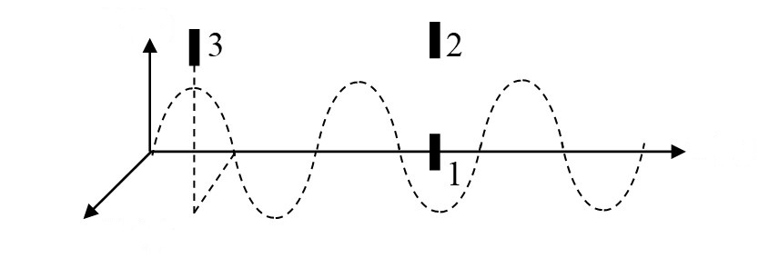
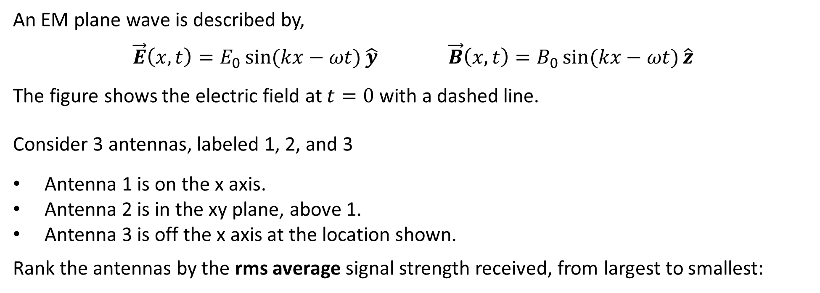
An EM plane wave is described by,
$\vec{E}\left(x,t\right)=E_{0}\sin{(kx−ωt)}\hat{y}$ $\vec{B}\left(x,t\right)=B_{0}\sin{(kx−ωt)}\hat{z}$
The figure shows the electric field at $t=0$ with a dashed line.
Consider 3 antennas, labeled 1, 2, and 3
Antenna 1 is on the x axis.
Antenna 2 is in the xy plane, above 1.
Antenna 3 is off the x axis at the location shown.
Rank the antennas by the rms average signal strength received, from largest to smallest:
$$y$$
$$x$$
$$z$$
1>2>3
1=2=3
1=2>3

Slide 11
Which has higher frequency?
Red light
Violet-blue light
Both have the same frequency
It depends on how the light is made

Slide 12
Imagine you are an alien from another planet with infrared eyes. What do you see when you look around the room?
Bright spots where the bodies are and dark elsewhere.
Dark spots where the bodies are and bright elsewhere.
The same as what we see, only everything looks red.
The same as what we see, except that red is invisible.

Slide 13
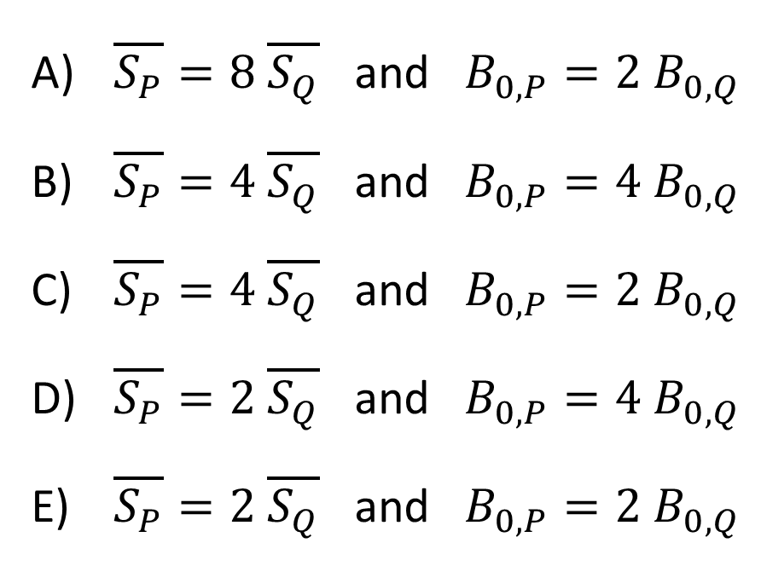
At a certain location, the electric field in the EM wave created by radio station P is stronger than that of radio station Q: $E_{0,P}=2 E_{0,Q}$. How do the intensities of these waves compare? How do the magnetic fields compare?
$\overline{S_{P}}=8 \overline{S_{Q}}$ and $B_{0,P}=2 B_{0,Q}$
$\overline{S_{P}}=4 \overline{S_{Q}}$ and $B_{0,P}=4 B_{0,Q}$
$\overline{S_{P}}=4 \overline{S_{Q}}$ and $B_{0,P}=2 B_{0,Q}$
$\overline{S_{P}}=2 \overline{S_{Q}}$ and $B_{0,P}=4 B_{0,Q}$
$\overline{S_{P}}=2 \overline{S_{Q}}$ and $B_{0,P}=2 B_{0,Q}$

Slide 14
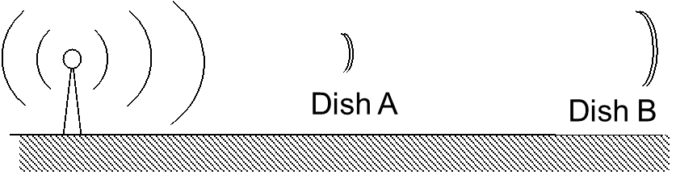
Two radio dishes receive signals from a radio station which is sending out radio waves in all directions with power $P$. Dish B is has twice the diameter of Dish A, but is twice as far away. What is the ratio of power received ($P_{A}/P_{B}$)?
1:1
2:1
4:1
16:1
None of these

Slide 15
An electromagnetic wave is created at point A and it propagates to point B. Consider the following statements:
The wave consists of a stream of electrons that pass from A to B.
An electromagnetic wave requires a “medium” of electrons that vibrate as the wave passes by.
Only statement I. is true
Only statement II. is true
Both statements are true
Neither statement is true

Slide 16
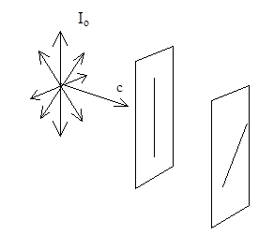
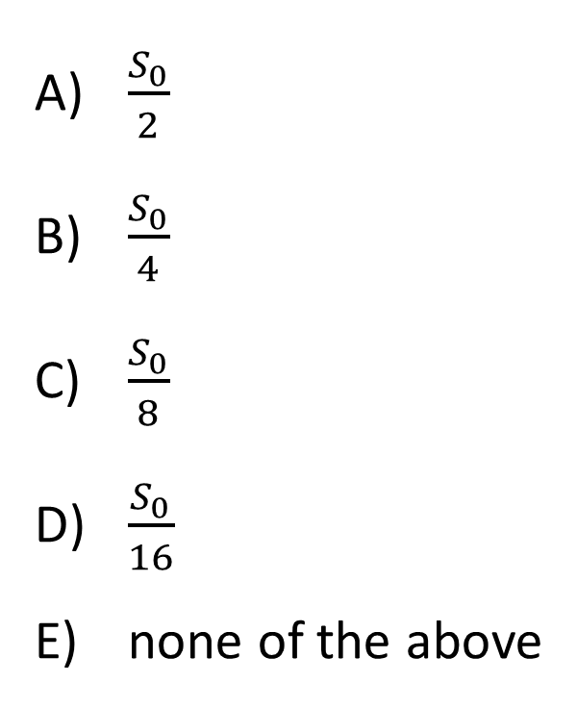
An unpolarized beam of light passes through 2 polaroid filters oriented at 45° with respect to each other. The intensity of the original beam is $S_{0}$. What is the intensity of the outgoing light after both filters? [Hint: $\cos{45°}=1/\sqrt{2}$]
$$S_{0}$$
$\frac{S_{0}}{2}$
$\frac{S_{0}}{4}$
$\frac{S_{0}}{8}$
$\frac{S_{0}}{16}$
none of the above

Slide 17
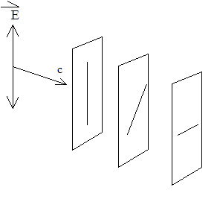
A polarized beam of light passes through three ideal polaroid filters. The filters, in order 1st, 2nd, 3rd, are tilted at 0º, 45º, and 90º with respect to the incoming beam's axis. Does any light get through the all the filters and come out the other side?
Some light gets through
No light gets through

Slide 18
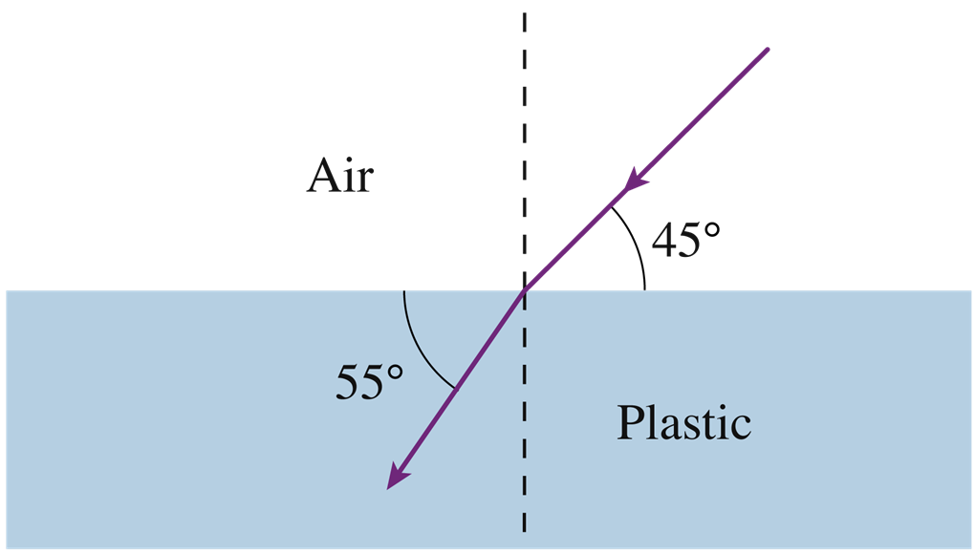
What is the angle of refraction for the light ray incident from air into plastic as shown?
35°
45°
55°
None of these

Slide 19
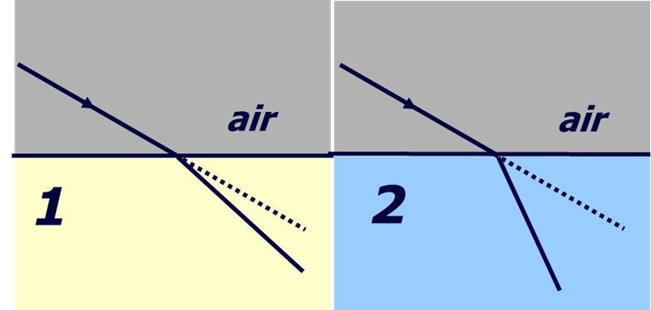
Parallel light rays cross interfaces from air into two different media, 1 and 2, as shown in the figures below. In which of the media is the light traveling faster?
Medium 1
Medium 2
Both the same

Slide 20
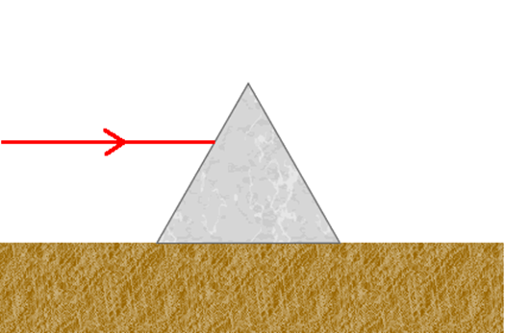
A horizontal light ray is incident on a triangular prism. After passing through the prism, the exiting light ray is…
deflected upwards.
horizontal.
deflected downwards.

Slide 21
A light ray inside glass (n=1.5) is totally internally reflected from an air-glass interface as shown.
Now, the air surrounding the glass is replaced with water (n=1.3). With the same light ray in the glass, will total internal reflection still occur?
Definitely not
Definitely
Not enough information to know

Slide 22
What will you see if you black out the bottom half of a full length mirror you’re standing in front of?
Your upper half
Your lower half
The same complete image
A monster

